Slide 1

Today’s objective
DATA ANALYTICS | IRONHACK

Slide 2

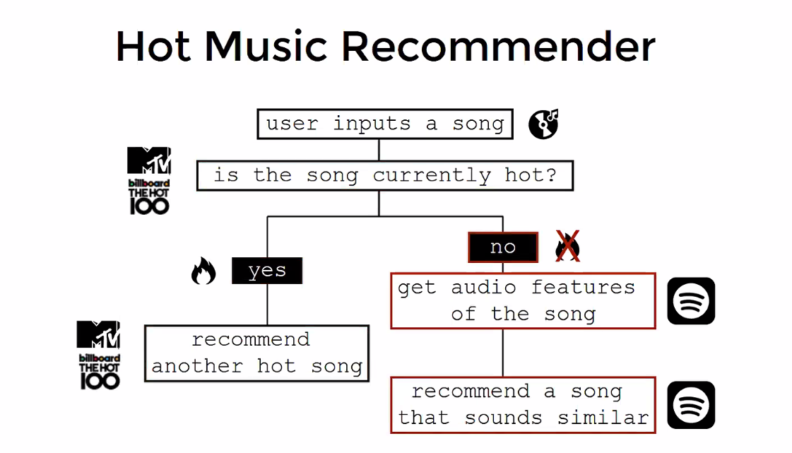
IRONHACK BOOTCAMP
Desired music recommender workflow

Slide 3
IRONHACK BOOTCAMP
Today’s objective:
Create a function to scrape the Billboards 100 HOT songs and create a local dataframe of songs with them including:
Song’s name
Song’s artist
Song’s album
Song’s release year

Slide 4


